Slide 1
Bank Marketing Project
Project Presentation
Akshay Vilayatkar

Slide 2
Introduction
Problem statement
Analyze the last marketing campaign that the bank performed and identify the patterns that will help us develop future strategies. Also predict whether the campaign will be successful.
Required to do :
(1)Perform preprocessing
(2)Do feature engineering
(3)Data visualizations to analyze the data
(4)Prediction of campaign's success

Slide 3
Business understanding
A Term Deposit is a deposit held at a financial institution that has a fixed term
When a term deposit is purchased, the customer understands that the money can only be withdrawn after the term has ended or by giving a predetermined number of days notice.
Term deposits are an extremely safe investment and are therefore very appealing to conservative, low-risk investors.
The goal of this project is to perform post-campaign analytics to identify the potential subscribers of the term deposit product for future campaigns

Slide 4
Data Understanding
Pdays –
95% of pdays are less than equal to 326.0
96% of pdays are less than equal to 343.0
97% of pdays are less than equal to 355.0
98% of pdays are less than equal to 369.0
99% of pdays are less than equal to 425.3
100% of pdays are less than equal to 854.0
IQR 21.25
Attribute pdays seems to be important feature as there is a clear distinction in quartile ranges of pdays for target variable yes and no. 75% clients contacted through campaign are not previously contacted.

Slide 5
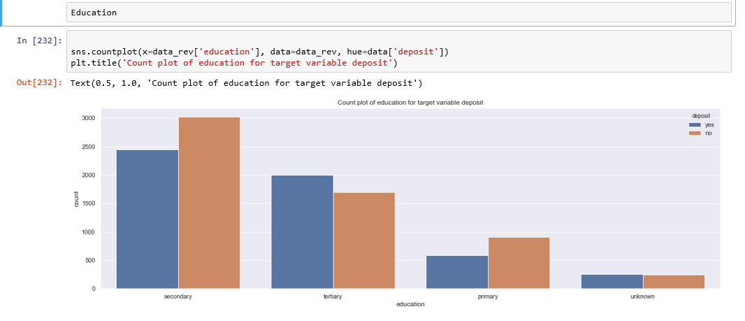
Data Understanding
Education
Most of the people who are contacted have tertiary or secondary education.

Slide 6
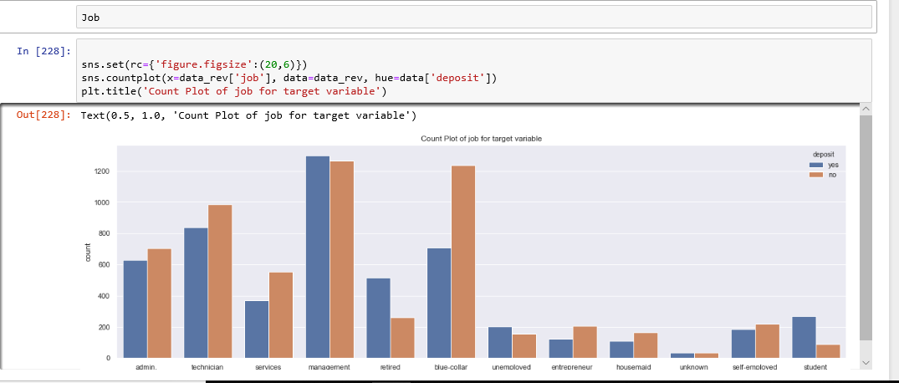
Data Understanding
Job
Top contacted clients are from job type: 'blue-collar', 'management' & 'technician’

Slide 7
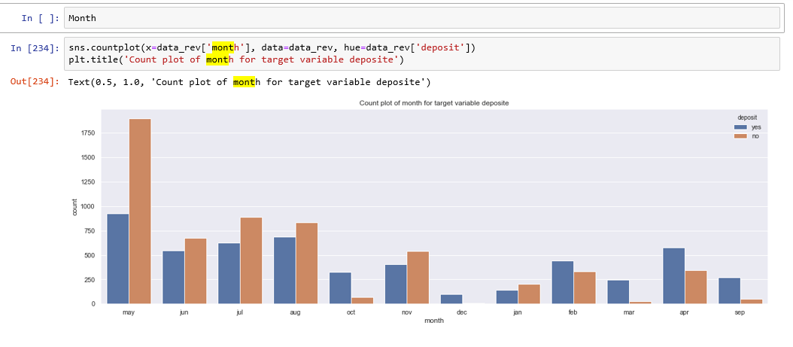
Data Understanding
Month
Most of the clients are contacted in the month of May

Slide 8
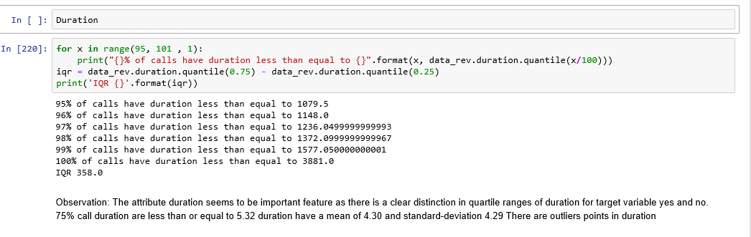
Data Understanding
Duration
The attribute duration seems to be important feature as there is a clear distinction in quartile ranges of duration for target variable yes and no.

Slide 9
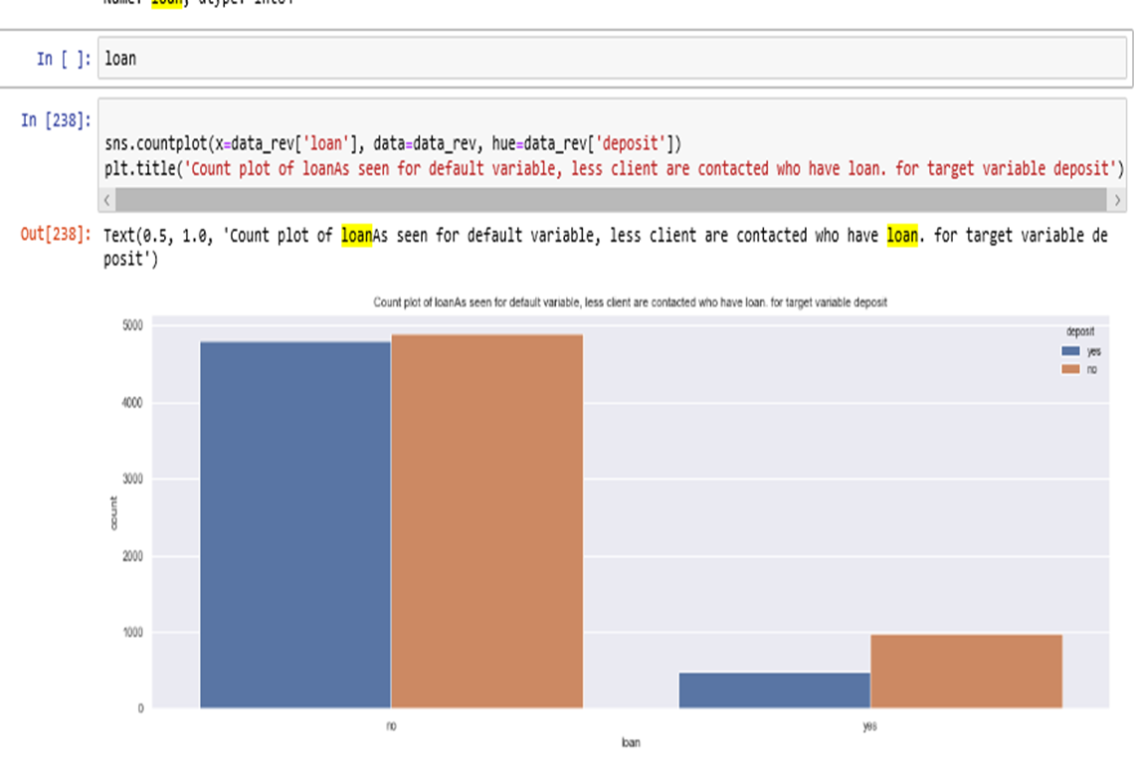
Data Understanding
Loan
Less client are contacted who have loan.

Slide 10
Data preparation
Separate out categorical and Numerical variable from main data frame.
Feature selection using decision tree method
Missing values are replace with mode in categorical variable whereas the missing values in numerical variable are replace with mean.
Convert all categorical variable into numerical variable using label Encoder.
Drop Branch variable has same value across whole column during the calculating correlation division by zero is yielding to NAN.
Analysis of every variable
Outlier detection using IQR

Slide 11
Modelling & Evaluation results
We tried a below techniques-
Decision trees
Logistic Regression
XGBoost
The most important variables
Age
balance
Day
Dduration
campaign
Pdays
previous

Slide 12
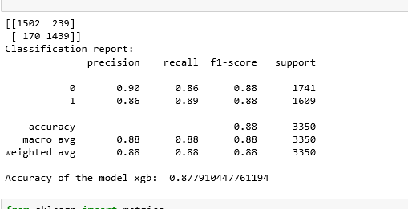
Confusion Matrix Result
We want high sensitivity and low false negative ratio (high negative prediction value) as the cost of making a call is likely much lower than misclassifying a potential subscriber as non-subscriber.

Slide 13
Conclusion
It was a great learning experience working on a financial dataset.
Our dataset consist of categorical and numerical features.
We have 19 independent features, out of these only half of them are important
'duration' is the most important feature while 'education' is the least important feature.
Month of May have seen the highest number of clients contacted
Different machine learning models are trained and tested on the dataset.
Xgboost algorithm reveal promising results .
Different models are summarized in table below

Slide 14
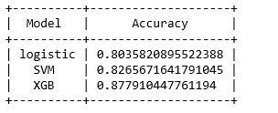
Summarized Below table provide you details about the accuracy of each model

Slide 15
Thank You

